Slide 1
Main features of the hadronic dark matter scenario
V. Kuksa and V. Beylin
Southern Federal University
Rostov-on-Don, Russia
Bled Workshop 2021

Slide 2
Contents
New quarks from SM extensions and hadronic DM.
Fundamental interactions of new singlet quarks and EW restrictions on new quarks.
Definition of mass of new quarks from DM relic density.
Evolution of heavy quark sector.
Quark structure and quantum numbers of new heavy hadrons. Stable particles.
Fine splitting and hyperfine structure of excited states and luminosity of hidden matter.
Effective interaction of new mesons with nucleons and leptons.
Conclusions.

Slide 3
SM extensions and DM candidates

Slide 4
Fundamental interactions and restrictions on mass of new quarks

Slide 5
Chromo - Coulomb effect

Slide 6
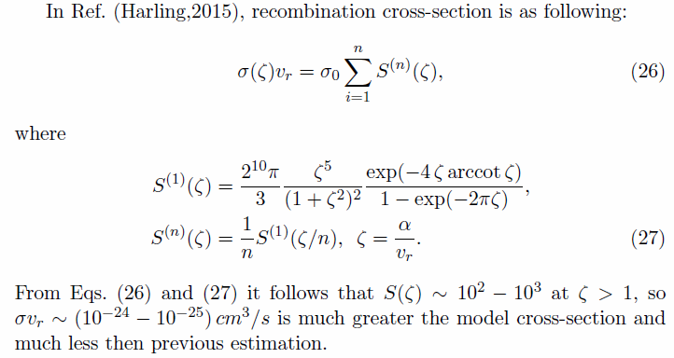

Slide 7
Evolution of new heavy quarks

Slide 8
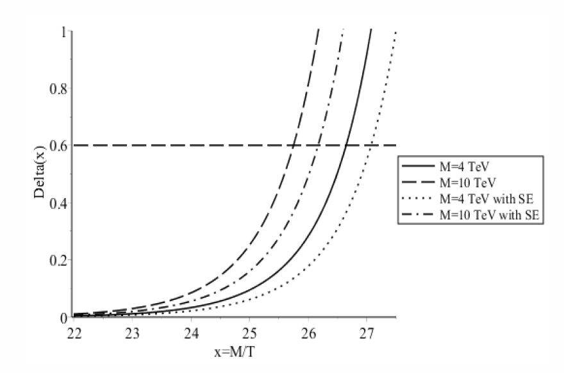
Dependence Delta(x)

Slide 9
Approach to Freeze-Out stage

Slide 10
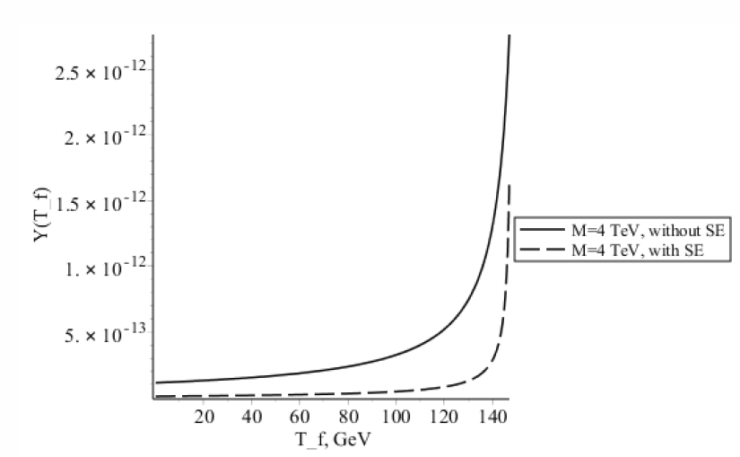

Slide 11
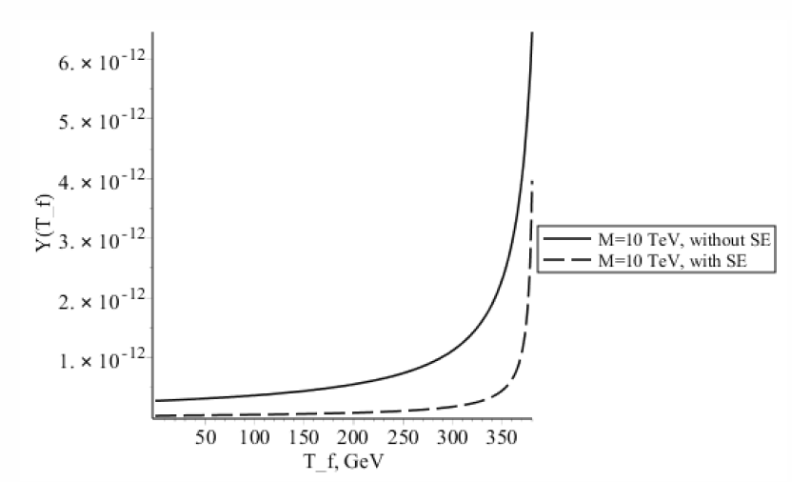

Slide 12
Determination of mass of new quarks from relic abundence of DM

Slide 13
Quantum numbers, isotopic and quark structure of new hadrons

Slide 14
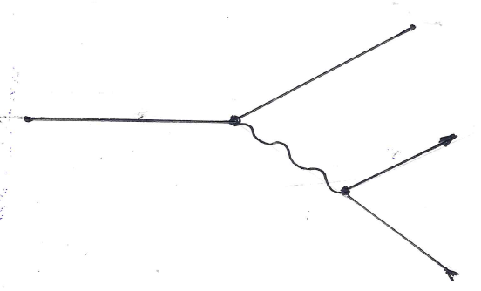
Fine and hyperfine structure of excited states of heavy hadrons

Slide 15
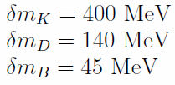
Hyperfine splitting

Slide 16
Luminosity of hidden matter

Slide 17
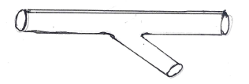
Low-energy interaction of nucleon and dark matter particles

Slide 18
One-meson exchange approach to NM-interaction

Slide 19
Cross-section of low-energy NM interactions

Slide 20
Interaction of hadronic DM with standard leptons

Slide 21
Cross-sections of DM-Lepton scattering

Slide 22
Conclusions
HDM is not excluded by EW and CC restrictions.
Analysis of HDM scenario with account of chromo-Coulomb interaction.
Large mass of DM hadrons (10 TeV and upper).
Signals of charge M-decay: metastable charge particle and low-energy leptons.
Hyperfine mass-splitting in M-M*: signals - low-energy photons (keV) and luminosity of DM.
Description of DM interaction with usual matter.

