Slide 1
Chemical evolution of antimatter domains in early Universe
Author: Dembitskaia A.I., NRNU MEPhI

Slide 2
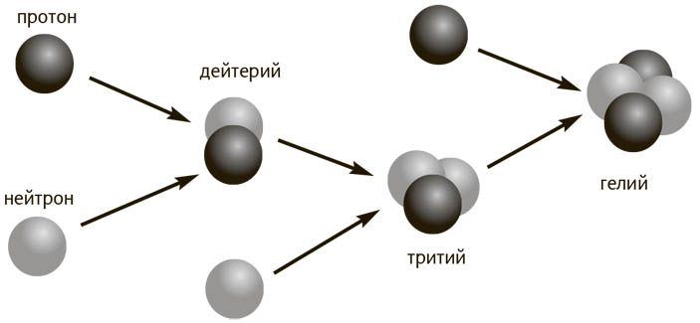
Nonhomogeneous baryosynthesis
Nonhomogeneous baryosynthesis scenario describes the mechanisms of local formation of antimatter domains
proton
deuterium
Predicted range of masses of macroscopic antimatter regions in the Milky Way Galaxy:
neutron
helium
tritium
2

Slide 3
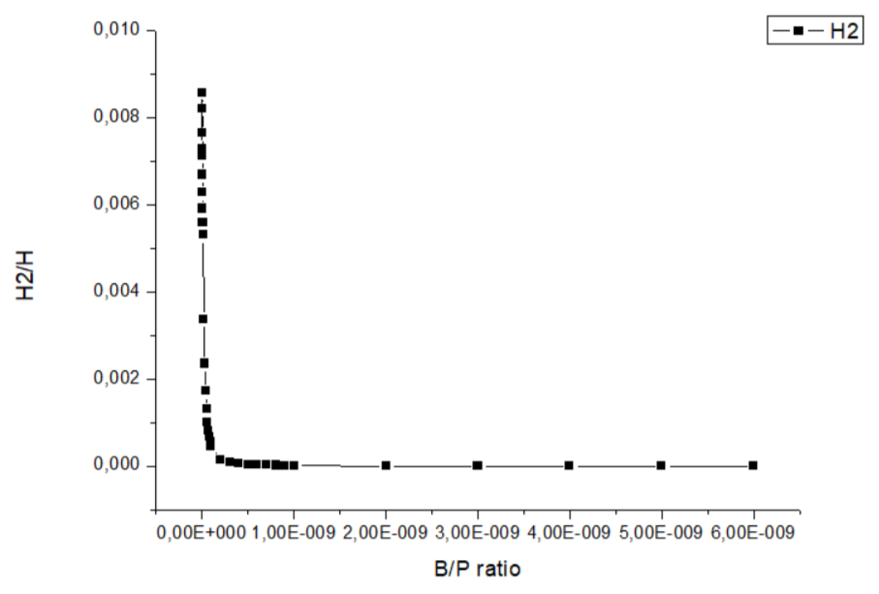
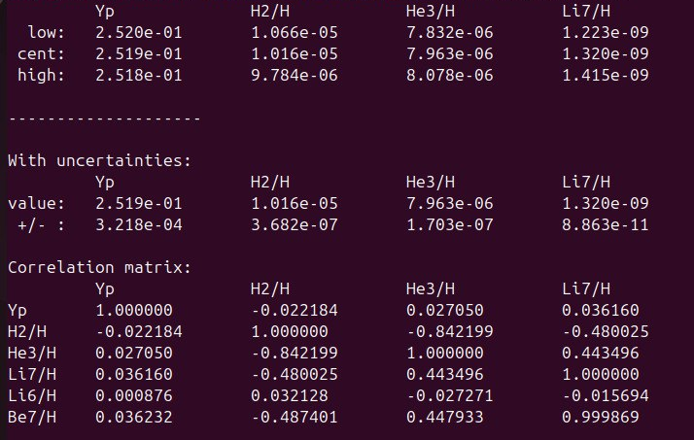
Antibaryon density
Baryon/photon ratio describes the number density of baryons, such as protons and neutrons, relative to the number density of photons in the universe
AlterBBN is a C program which computes the abundances of the elements predicted by
Big-Bang nucleosynthesis (BBN)
Figure 1. Dependence of the 2H’s mass fraction on baryon/photon ratio
3

Slide 4
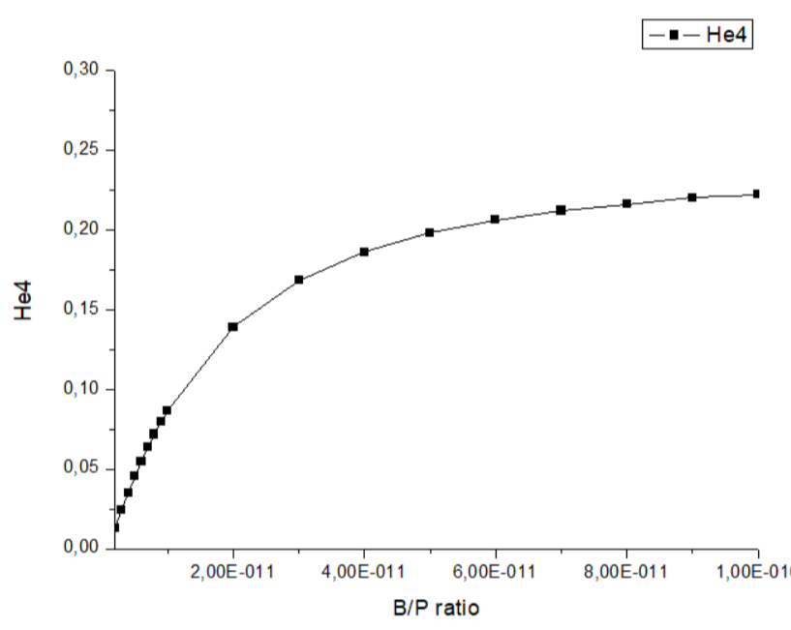
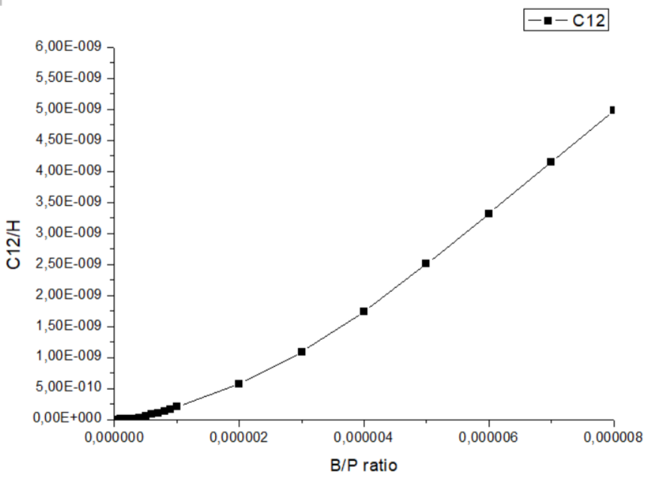
The results obtained
Figure 2. Dependence of the 4He’s mass fraction on baryon/photon ratio
Figure 3. Dependence of the 12С’s mass fraction on baryon/photon ratio
4

Slide 5
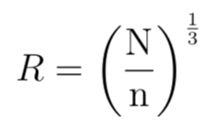
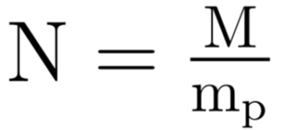
Size of the domain
Size of the domain:
Main formula:
Parameters:
5

Slide 6
Processes at the border
Criterion of annihilation processes at the border of the domain:
According to the main parameters:
Products of annihilation will penetrate the domain
Figure 4. Eras of the Universe

Slide 7
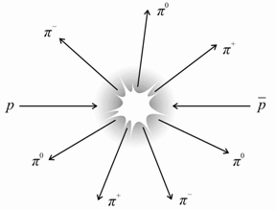
Proton-antiproton annihilation
Main channels:
Production of photons due to neutral pion decay
Production of electrons and positrons due to charged pion decay involving muon production

Slide 8
Interaction between thermal and annihilation photon
High energy thermal photon distribution:
Temperature
range:
Possible result of the reaction: production of electron-positron pair
Breit–Wheeler formula:
8

Slide 9
Charged pion decay
Energy distribution of the electrons emitted in muon decay:
Figure 5. Experimental spectrum of positrons
(Source: M. Bardon et al., Phys. Rev. Lett. 14, 449 (1965).)
9

Slide 10
Compton scattering
Temperature range:
Energy loss:
Klein–Nishina formula:
Multiple scattering
(>2500)
10

Slide 11
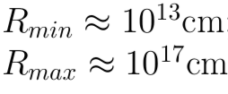
Penetration depth of photons
Dominant process: pair production
Comparison with the domain’s size:
Penetration depth of photons is significantly less than domain radius

Slide 12
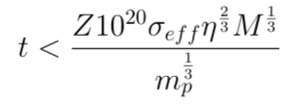
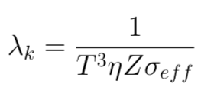
Penetration depth of photons
Dominant process: Compton scattering
Taking into account temperature
restrictions:

Slide 13
Conclusion
-Size of the domain has been estimated
-Processes at the border of the antimatter domain were studied and described
-Penetration depth of photons inside the antimatter domain has been estimated
Perspectives:
More accurate and detailed description of processes at the border and inside the antimatter domain over time
13

Slide 14
Thank you for your attention!
Contacts:
Mail: demanna2004@yandex.ru
Phone number: +7 (985) 749-45-52
14

